Slide 1

17/12/2024

Slide 2
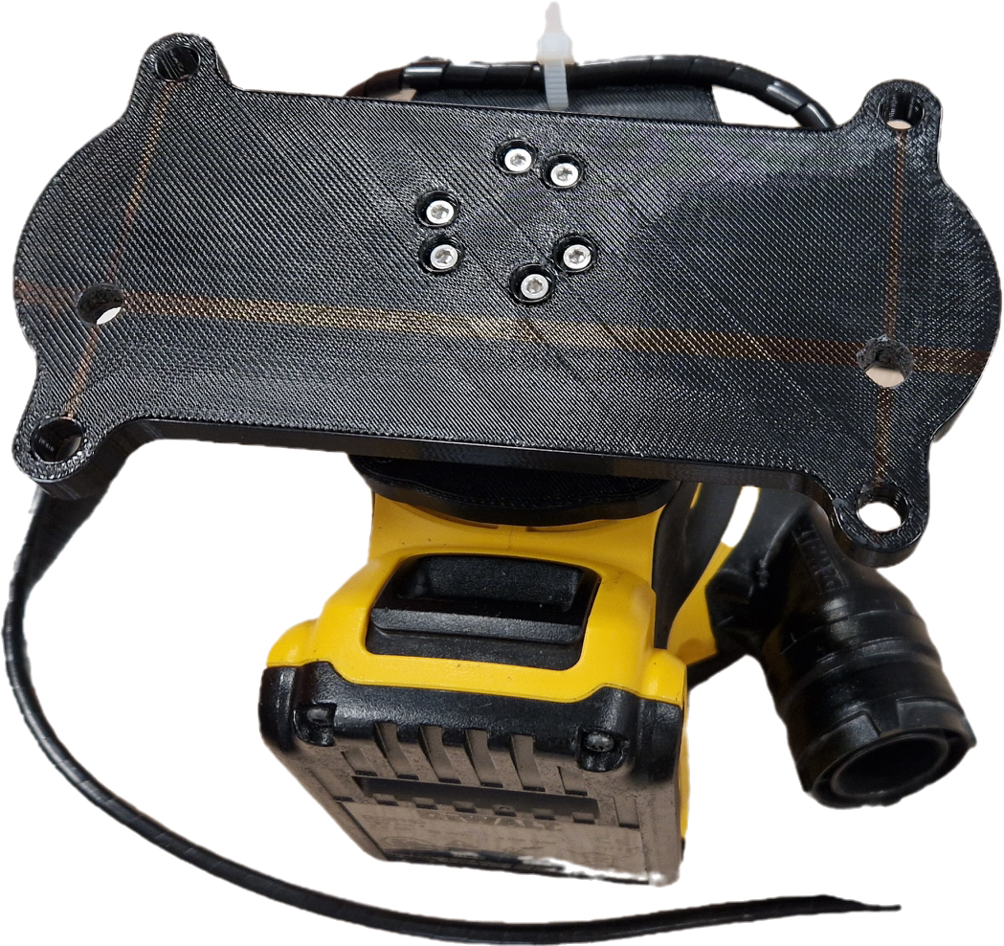
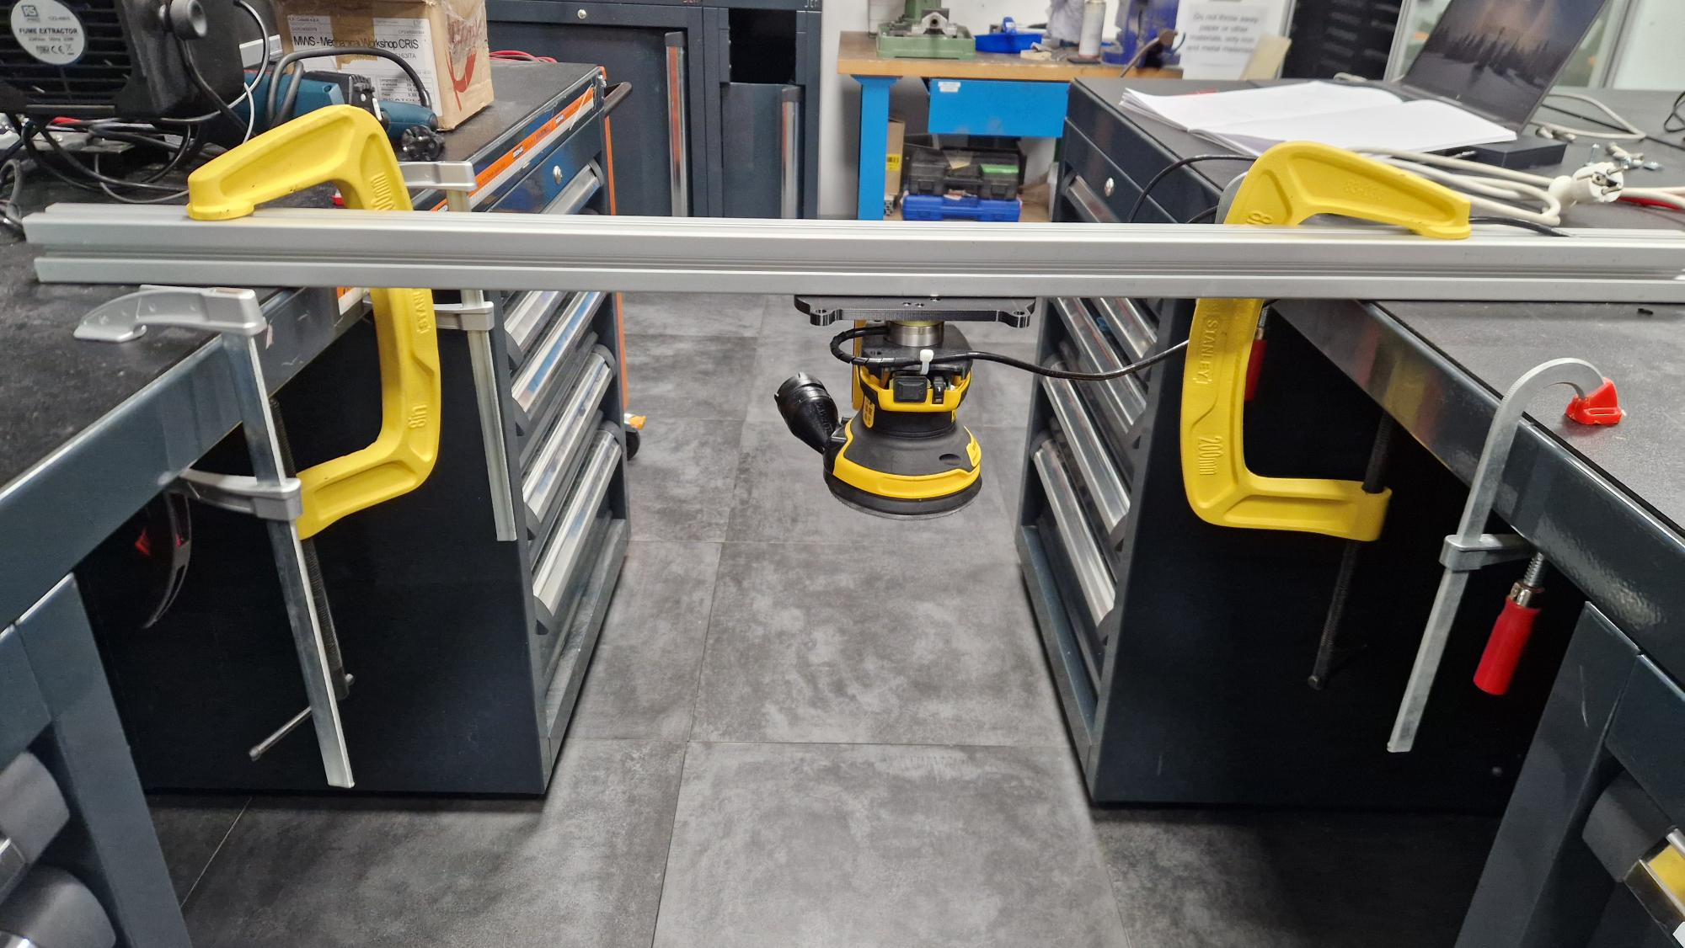
Free- Free condition Experiment:
Performed an experiment where the tool along with the FT sensor is rigid fixed to a simple supported beam and conducted a vibration analysis.
For the complete range of speed (1-7) obtained the readings of the Force values for a duration of 15 seconds.

Slide 3
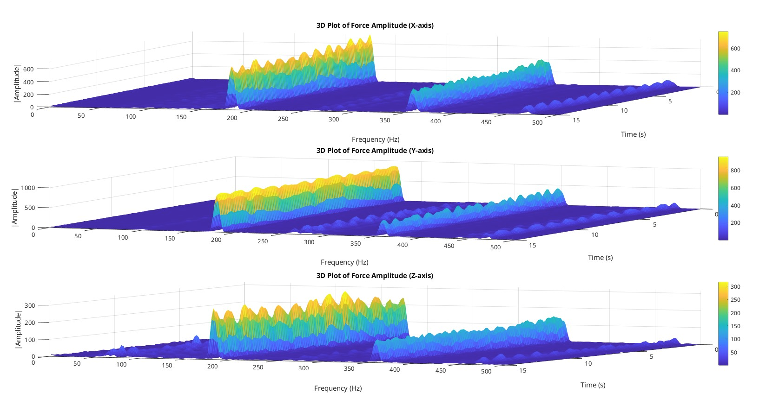
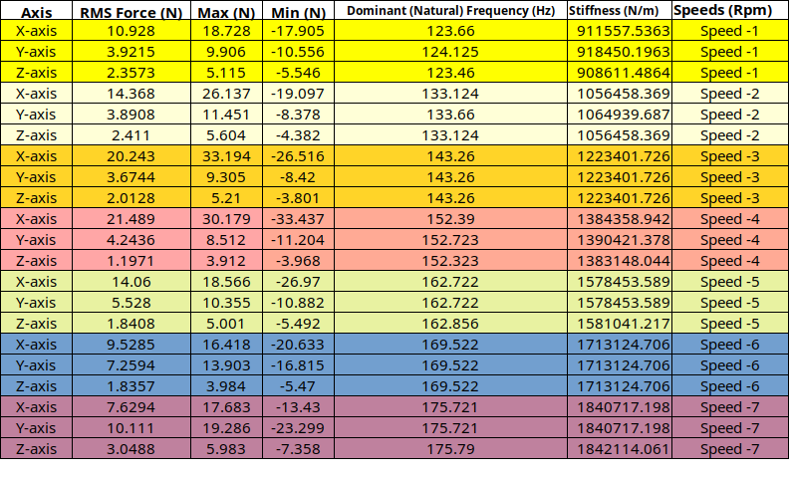
Results from the Experiment:
From the obtained data of forces made a comprehensive graphs to understand and visualize the data.
Found the systems natural frequency by using FFT along with their respective stiffness values.
Speed Increasing

Slide 4
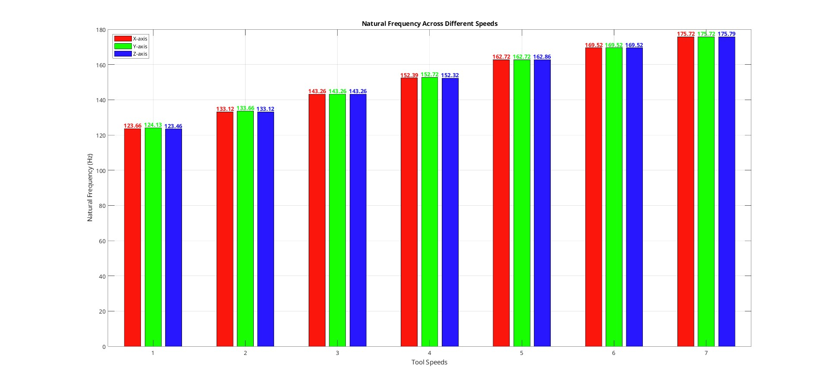
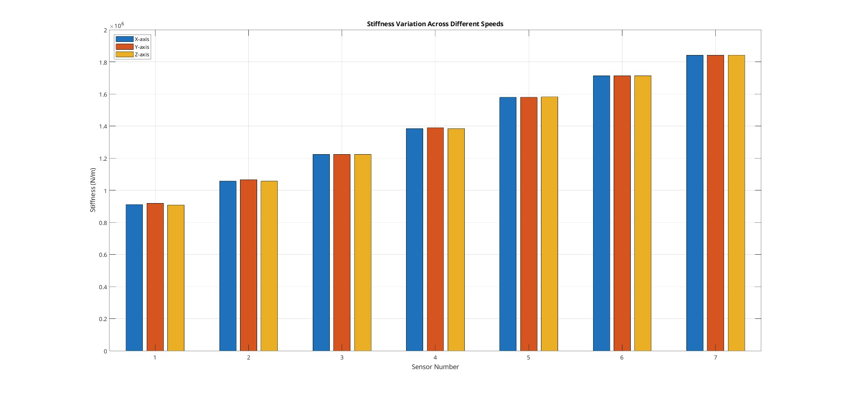
Results from the Experiment:

Slide 5
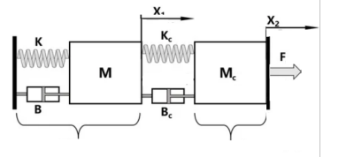
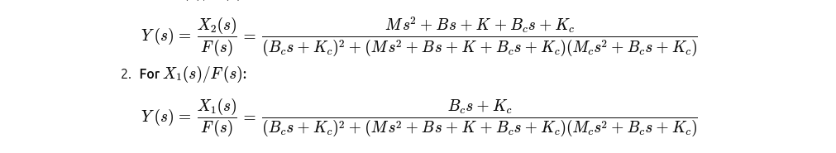

Transfer Function Calculation:
For the Macro-Mini Manipular system with input as force and output as displacement.
The Transfer function Y(s) is :
Model of simplified macro-mini manipulator system [ Dai, J.; Chen et.al 2021]
Dai, J.; Chen, C.-Y.; Zhu, R.; Yang, G.; Wang, C.; Bai, S. Suppress Vibration on Robotic Polishing with Impedance Matching. Actuators 2021

Slide 6
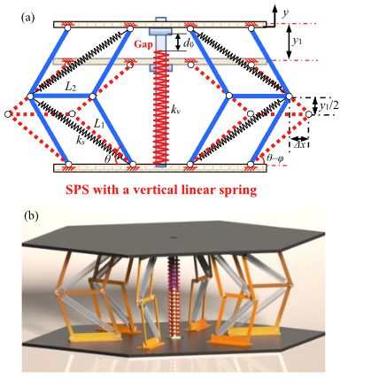
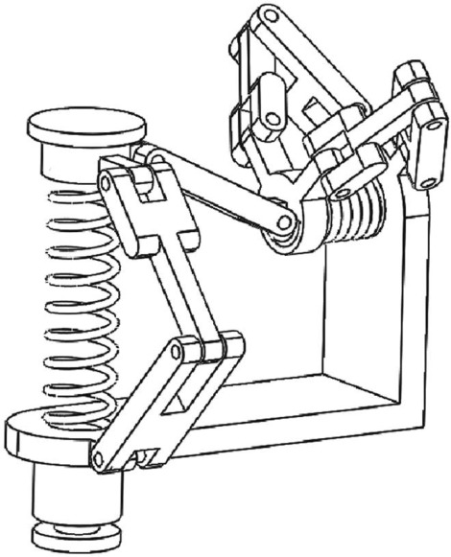
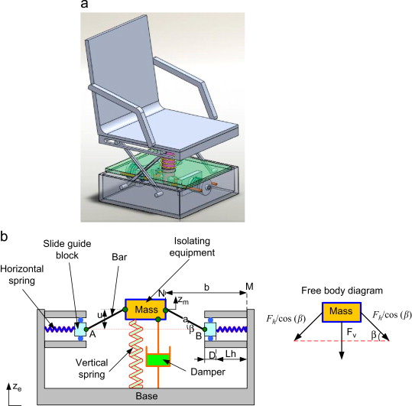
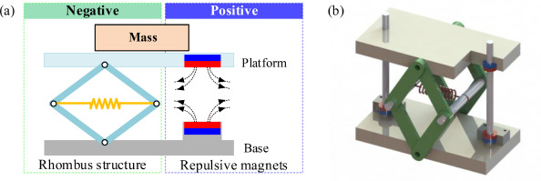
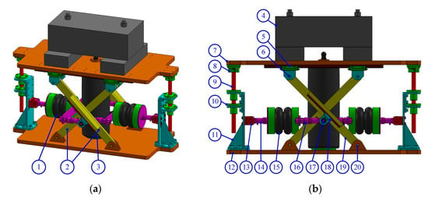
Few Ideas for designing a passive isolator system
P. Lambert, J.L. Herder
An adjustable constant force mechanism using pin joints and springs
Mechanical model of isolation system.
Dalela, S., Balaji, P.S., Leblouba, M. et al. Nonlinear static and dynamic response of a metastructure exhibiting quasi-zero-stiffness characteristics for vibration control: an experimental validation. Sci Rep 14, 19195 (2024)
anti-vibration structure (LAVS) via linear positive and negative stiffness compensation mechanism
Chai, Yuyang, Jing Bian, and Meng Li. "A novel quasi-zero-stiffness isolation platform via tunable positive and negative stiffness compensation mechanism." Nonlinear Dynamics 112.1 (2024): 101-123.
Nonlinear compensation method for quasi-zero stiffness vibration isolation
Air Spring Vibration Isolator Based on a Negative-Stiffness Structure
Yan, Ge, et al. "Nonlinear compensation method for quasi-zero stiffness vibration isolation." Journal of Sound and Vibration 523 (2022): 116743.
Nguyen, C.H.; Ho, C.M.; Ahn, K.K. An Air Spring Vibration Isolator Based on a Negative-Stiffness Structure for Vehicle Seat. Appl. Sci. 2021,

Slide 7
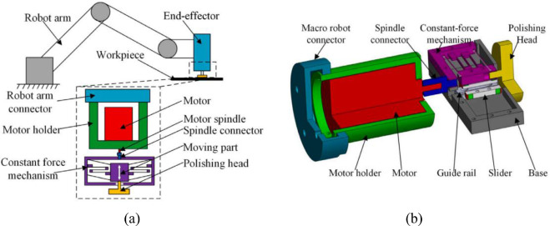
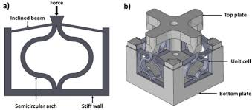
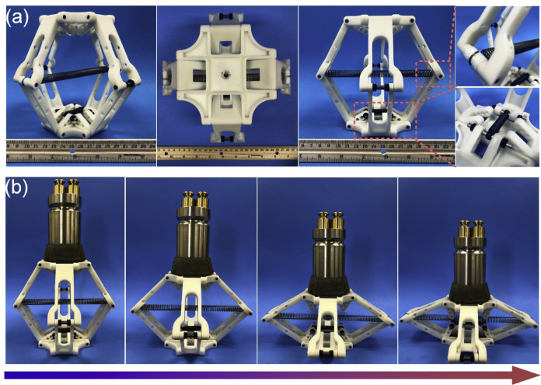
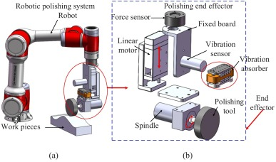
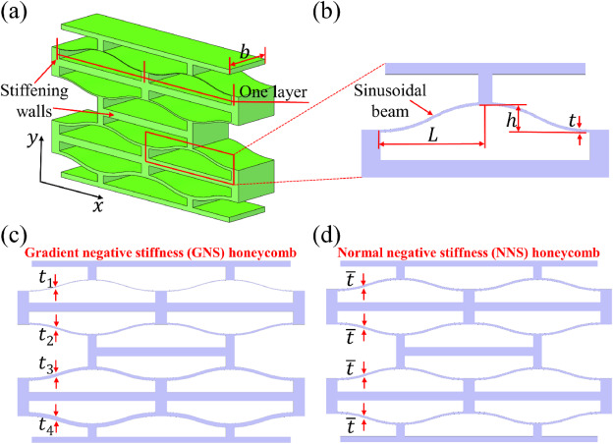
Few Ideas for designing a passive isolator system
quasi-zero-stiffness metastructure -
Y. Wei, Q. Xu
Design of a new passive end-effector based on constant-force mechanism for robotic polishing - 2022
Dalela, S., Balaji, P.S., Leblouba, M. et al. Nonlinear static and dynamic response of a metastructure exhibiting quasi-zero-stiffness characteristics for vibration control: an experimental validation. Sci Rep 14, 19195 (2024)
Design of the novel GNS honeycomb negative stiffness energy absorption
(a) Photographs of the fabricated metamaterial. (b) Equilibrium of the metamaterial at any position.
Passive vibration absorber using magnets.
Chen, Shuai, et al. "A novel gradient negative stiffness honeycomb for recoverable energy absorption." Composites Part B: Engineering 215 (2021): 108745.
Xu, Du, Xinjiang Lu, and Bowen Xu. "Design and modeling of a passive magnetic vibration absorber for robotic polishing process." Journal of Manufacturing Processes 95 (2023): 204-216.
Wu, Lingling, et al. "Mechanical metamaterials for full-band mechanical wave shielding." Applied Materials Today 20 (2020): 100671.

Slide 8
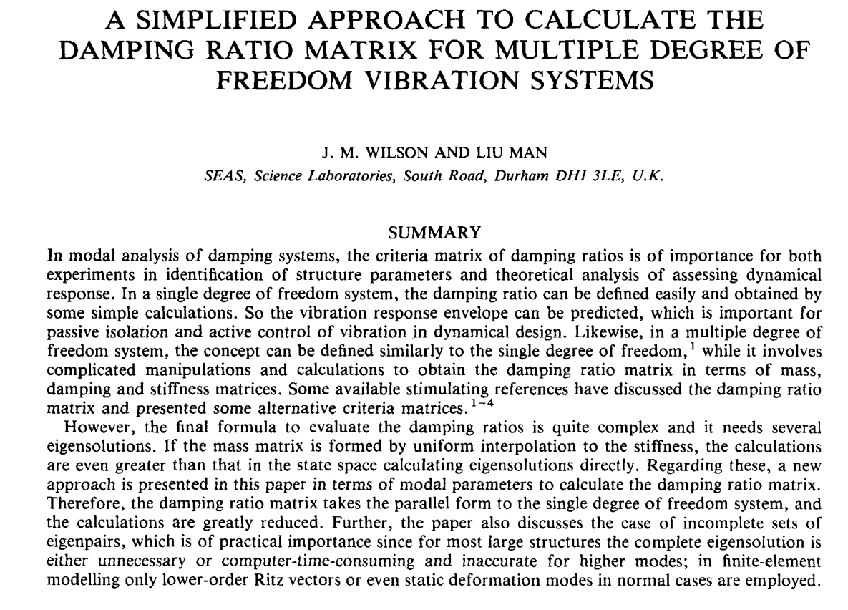
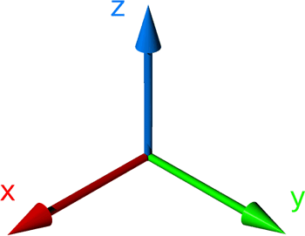
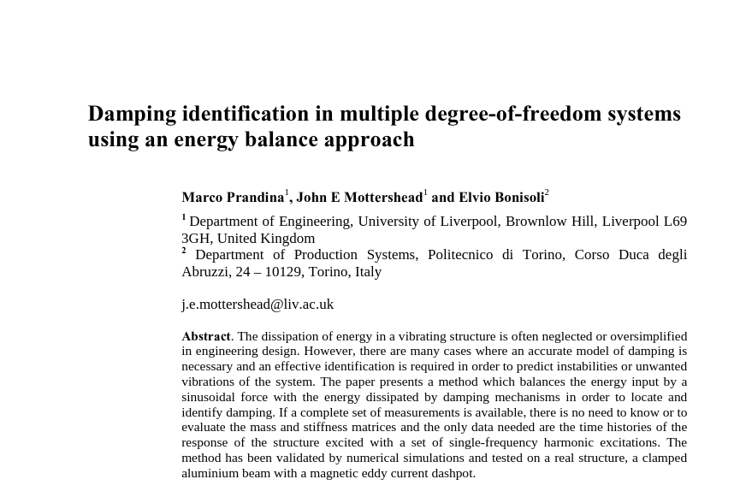
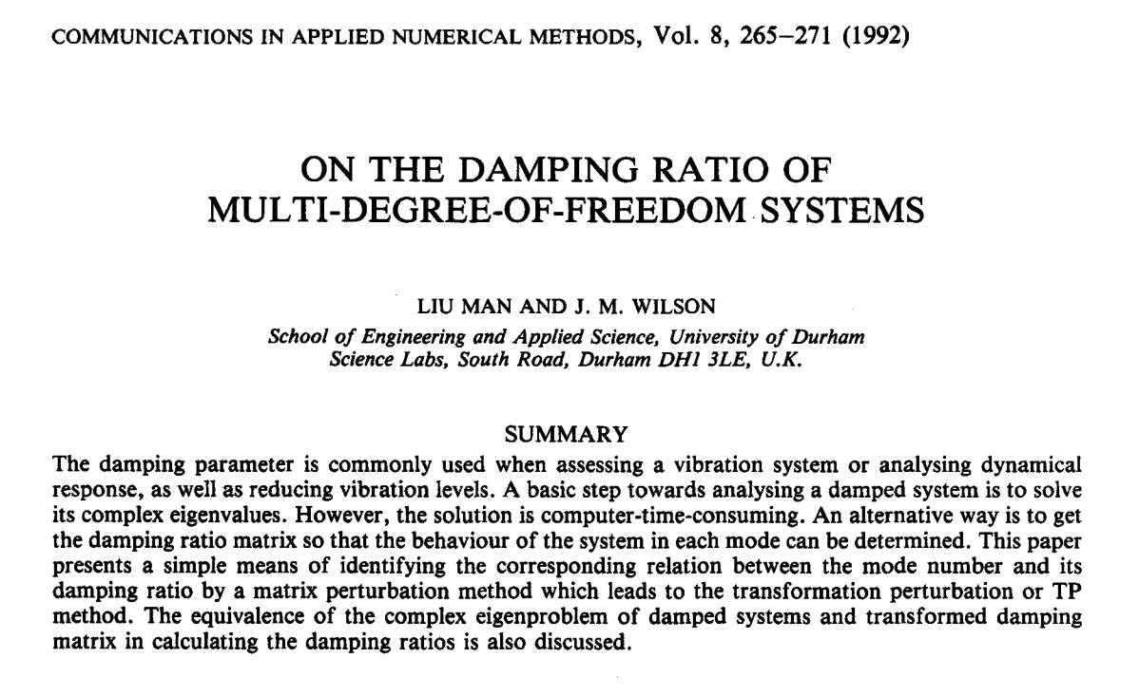
Current Papers I need to refer for finding damping ratio in MDOF
Since, the current random orbital tool is considered as a 3 DOF ( 2 translations, 1 rotation) rigid body.

Slide 9

Thank you very much for your attention...

